Slide 1
Svena Yu
Project Showcase
https://miyesven.github.io/

Slide 2
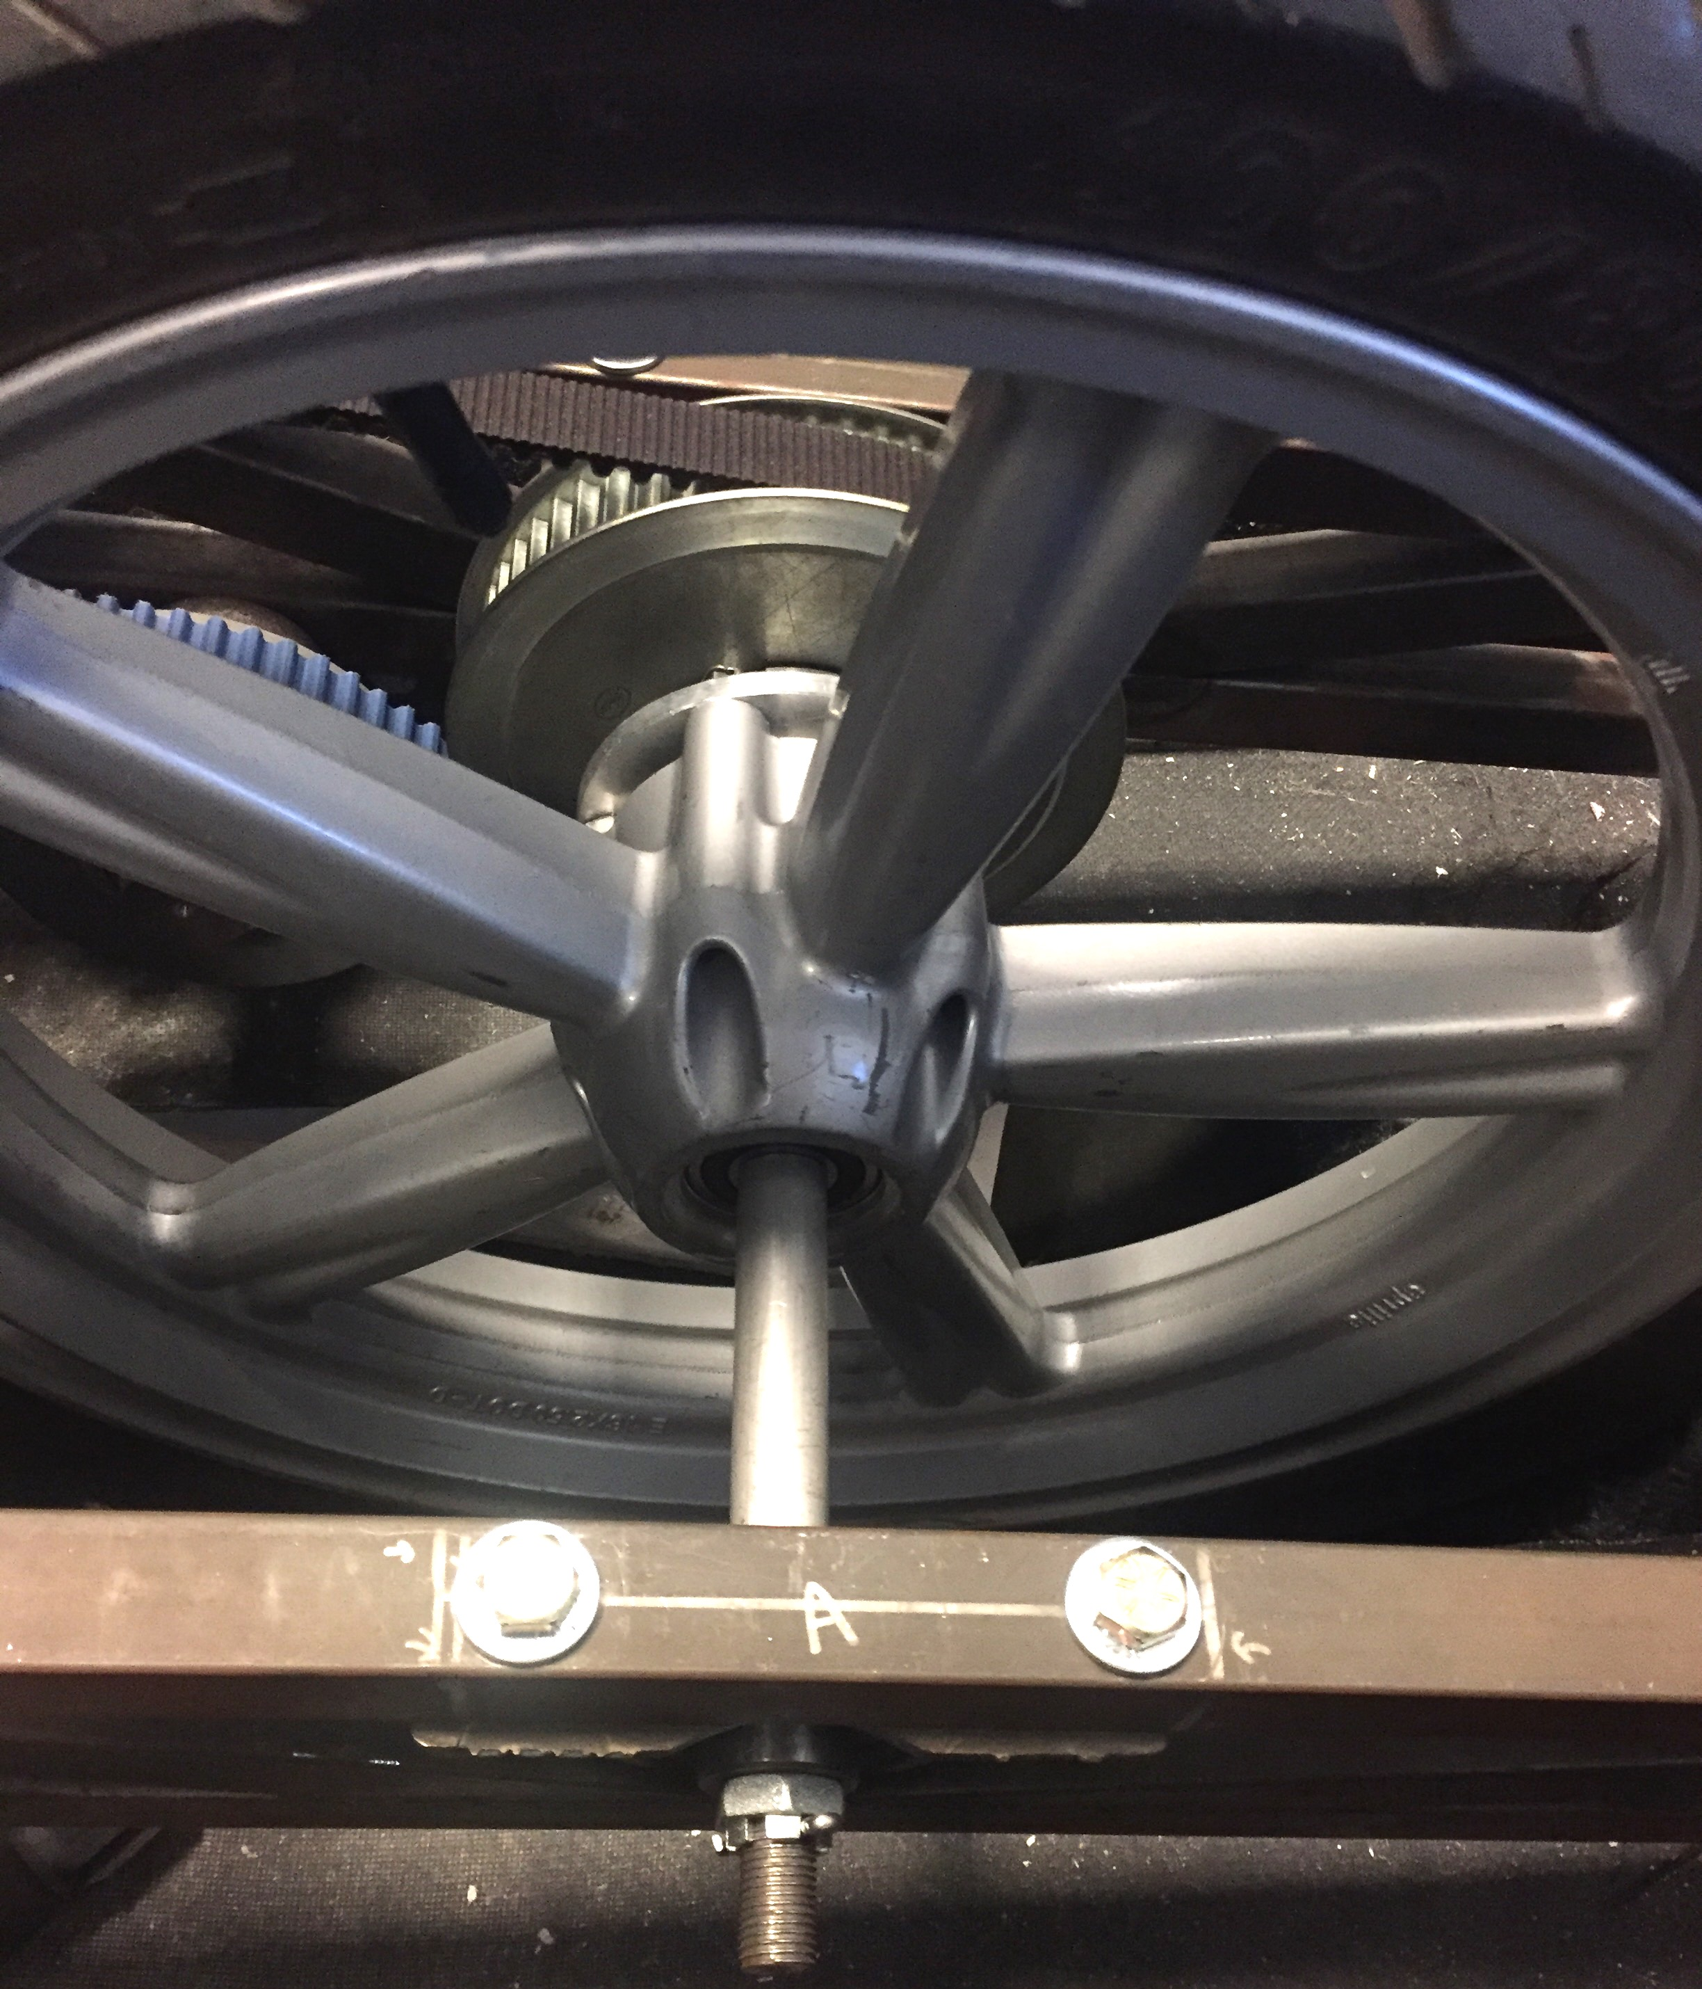
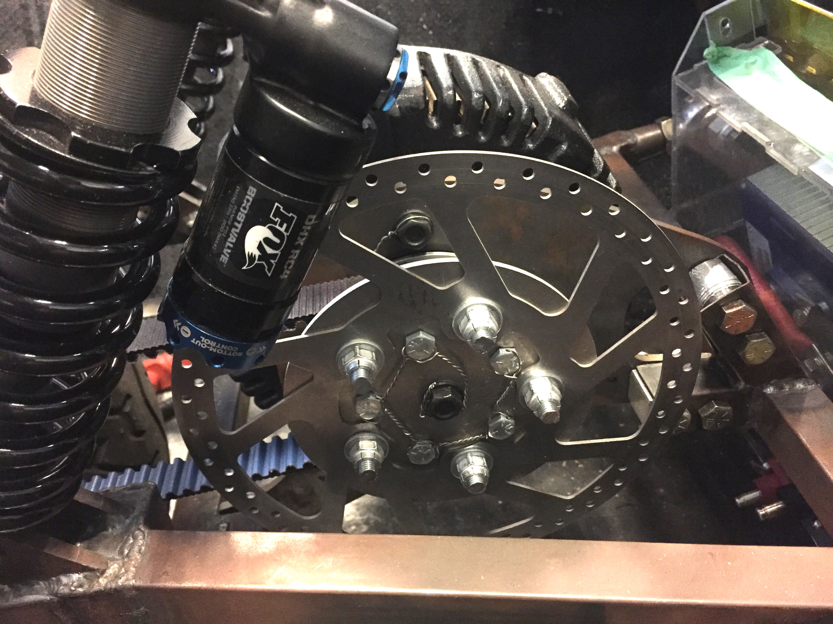
Motor / Wheel Assembly
Designed motor mount & parking brake
Redesigned wheel assemblies for better integration
Fabricated shafts, adapters, mounting tabs
Above
Rear drivetrain wheel assembly
Right
Parking brake, motor mount, motor assembly

Slide 3
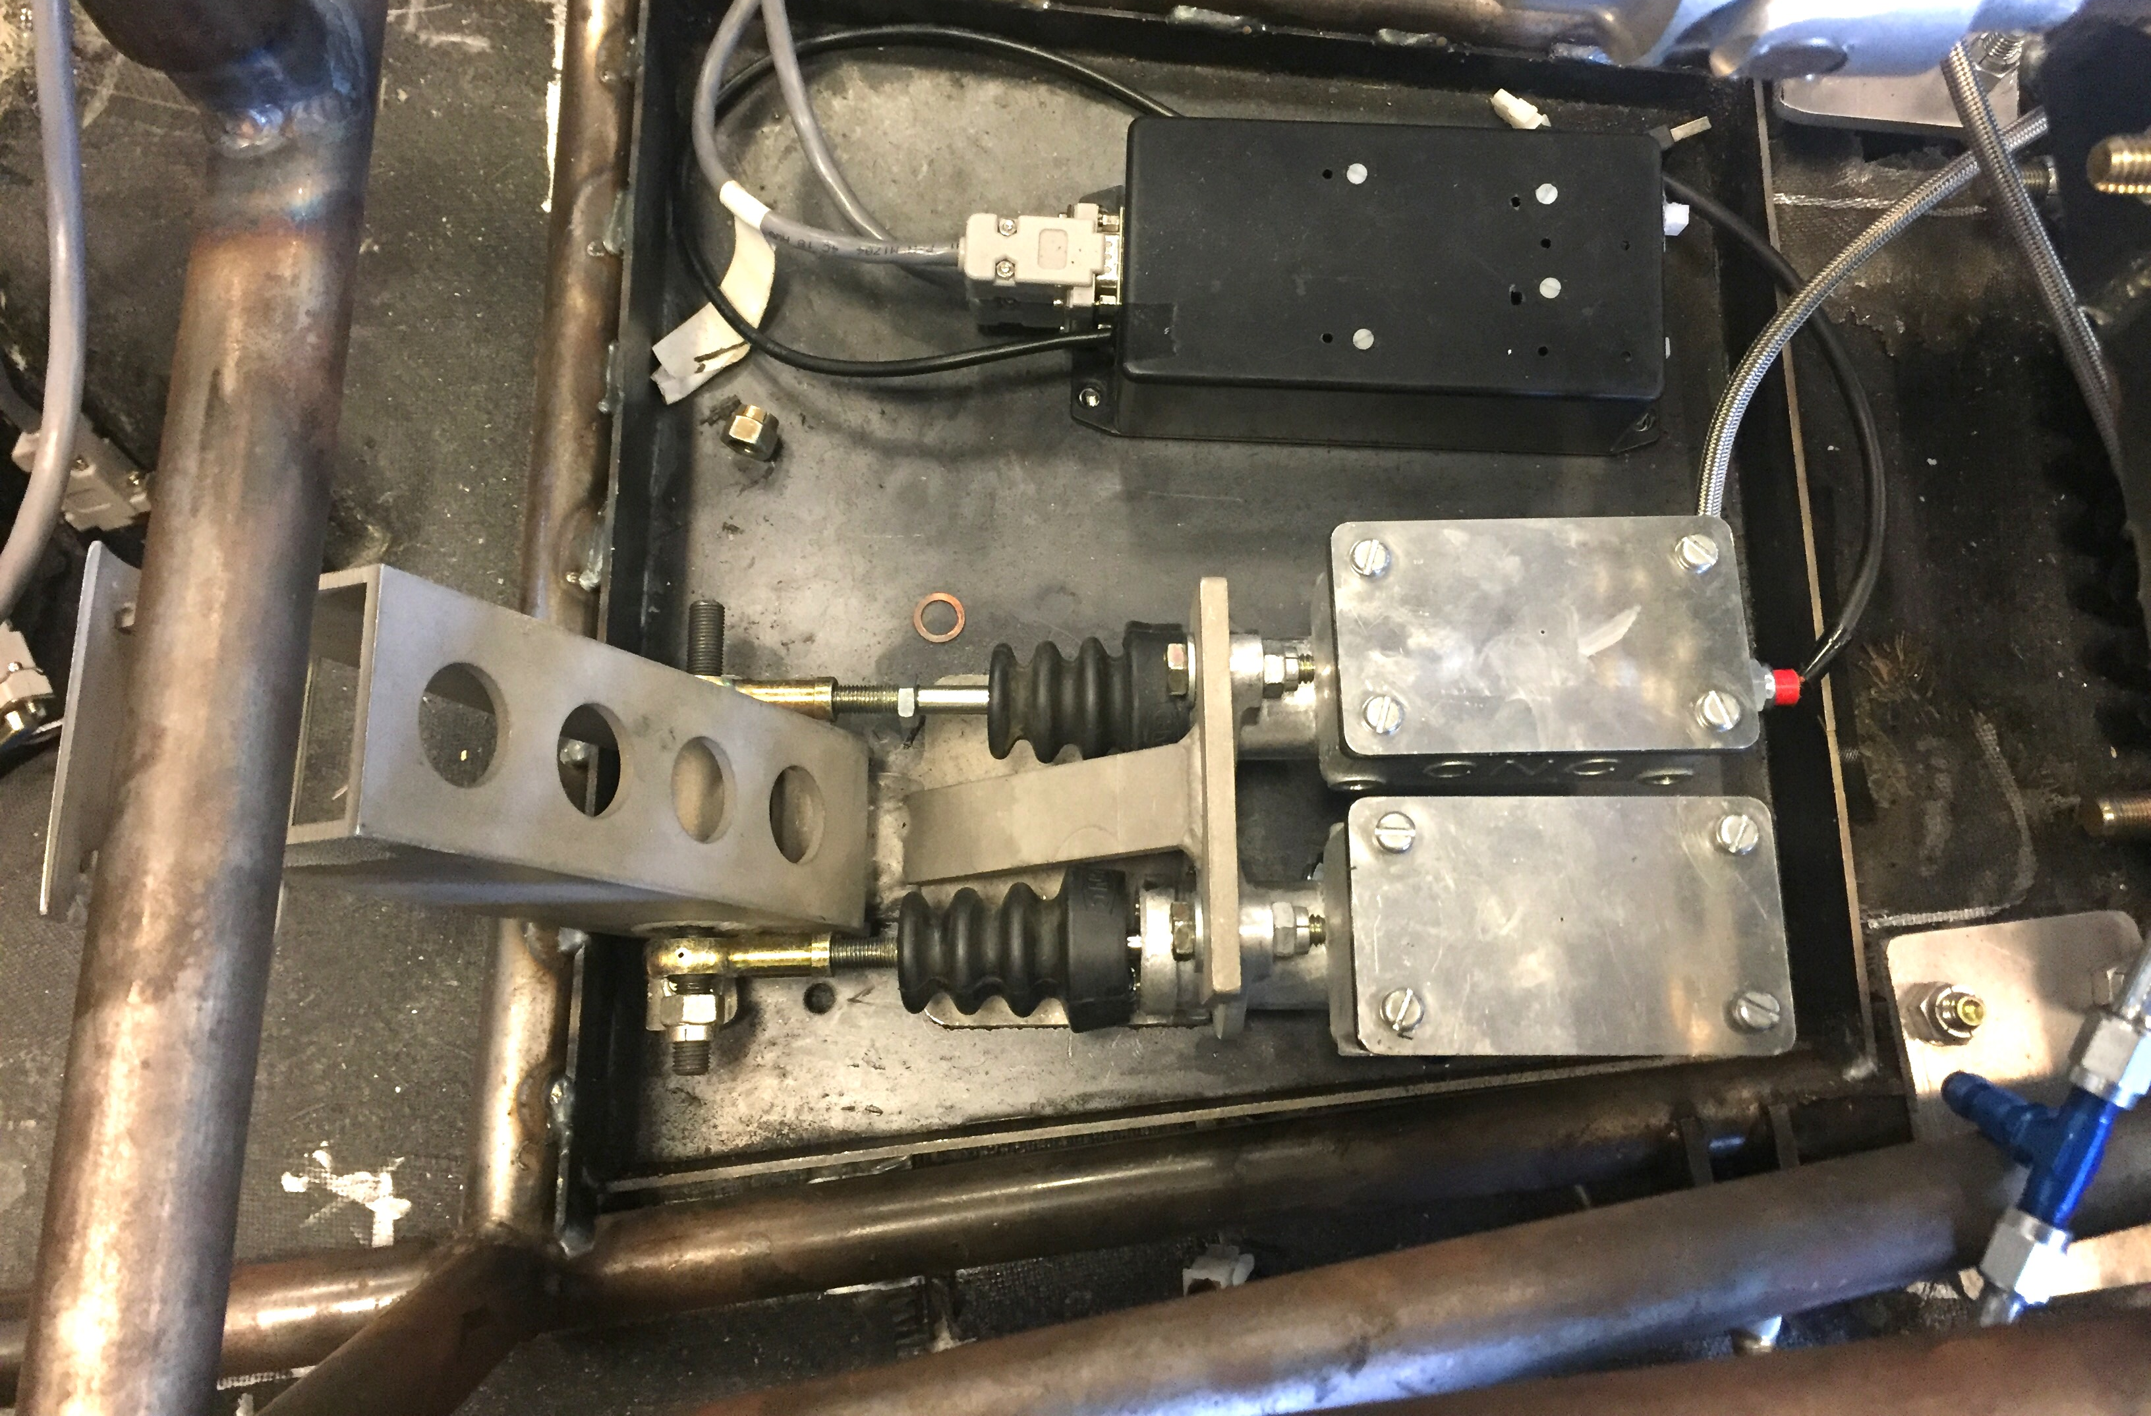
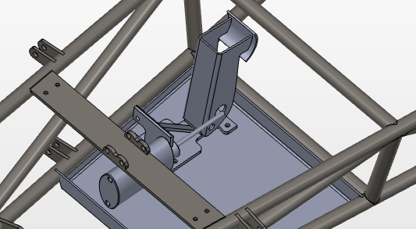
Brake Pedal
Redesigned the brake pedal assembly to fit the frame
Designed brake pedal mount
Above
Brake pedal mounted in frame with brake pedal mount
Right
- Solidworks model in assembly

Slide 4
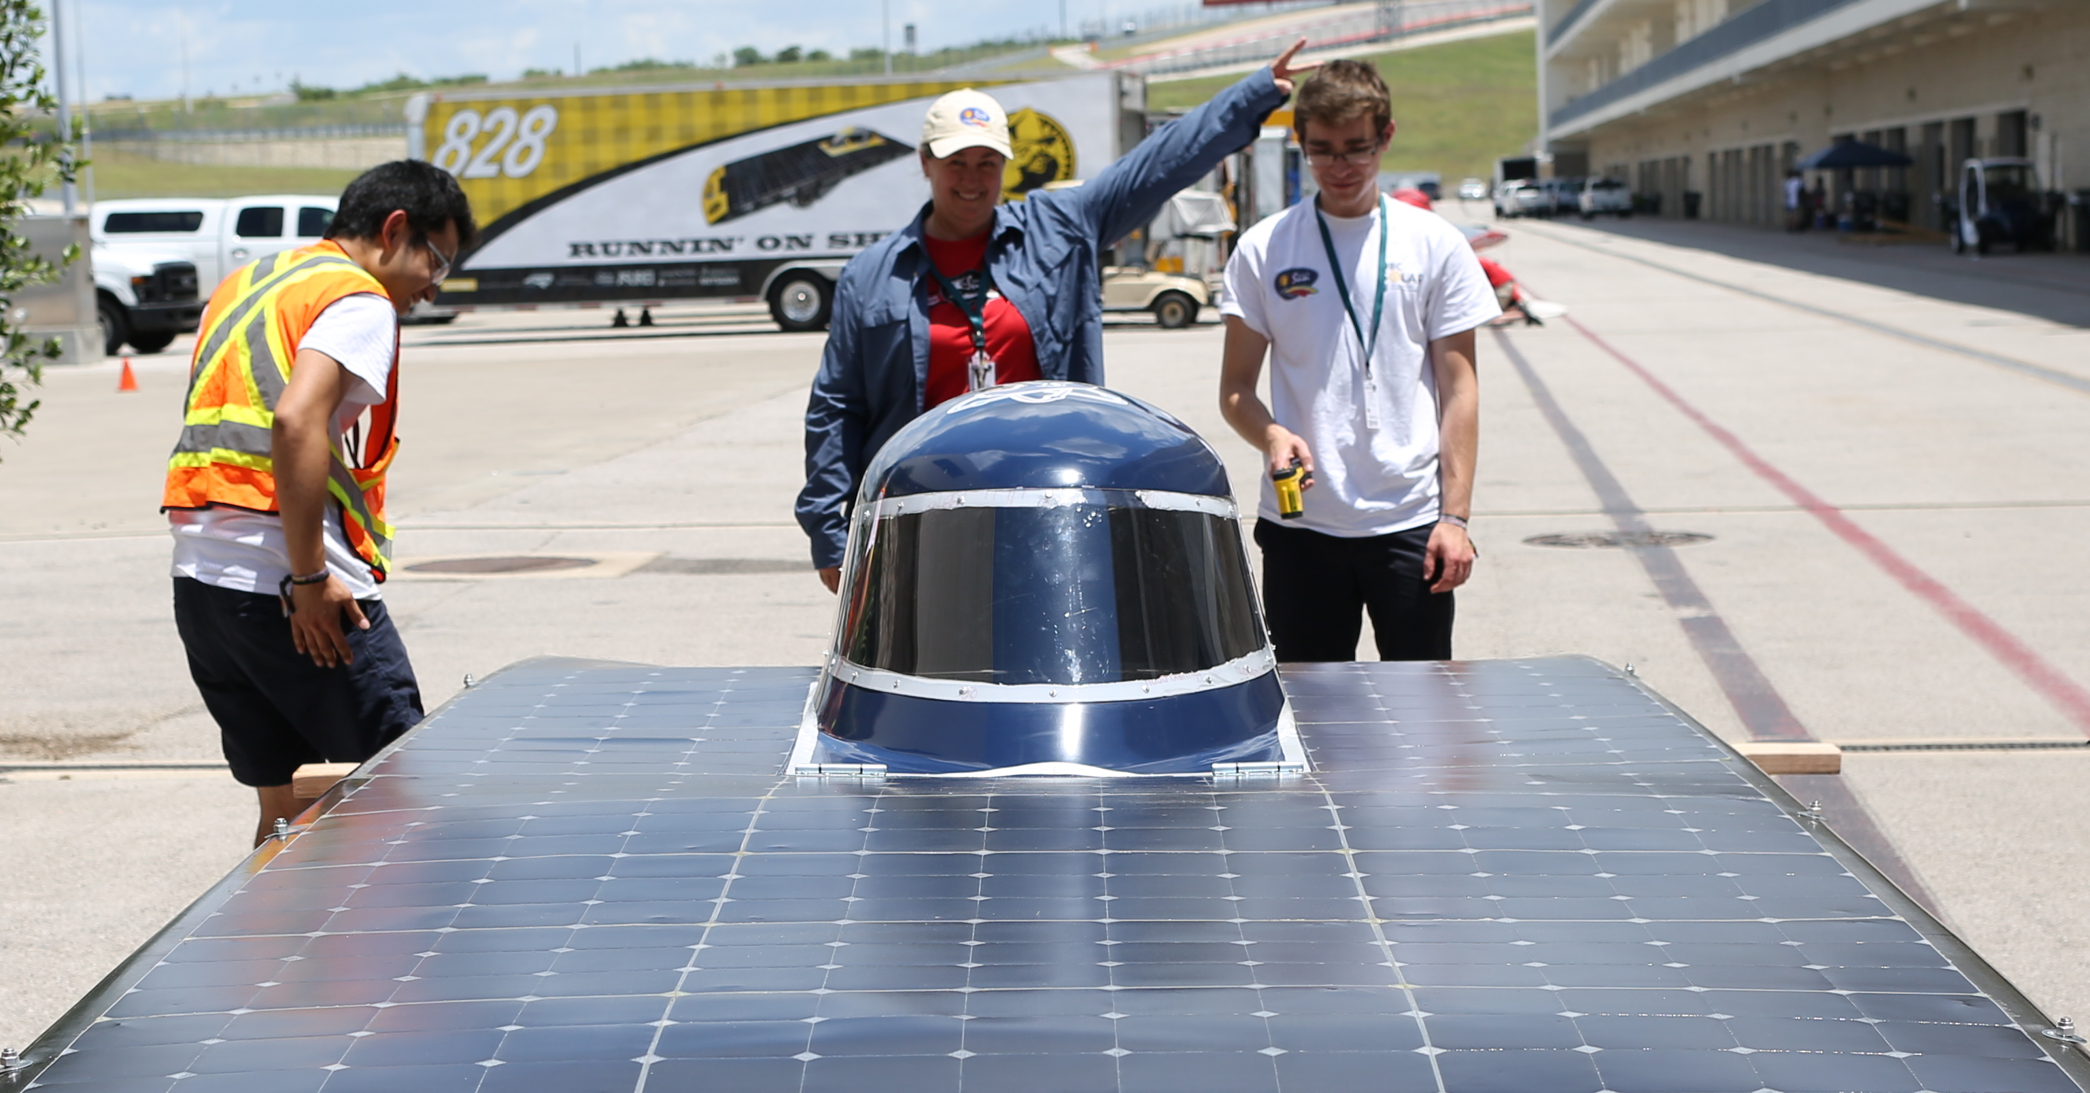
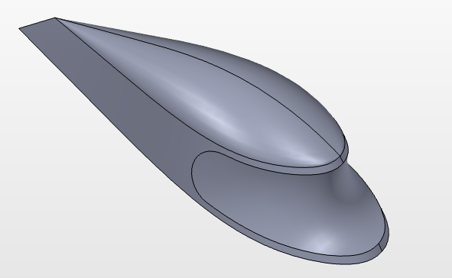
Canopy
Designed and fabricated the plug
Oversaw fabrication for the rest of the canopy
Above
Integrated Canopy with top shell w/ Egress system
Right
Canopy model with windshield

Slide 5
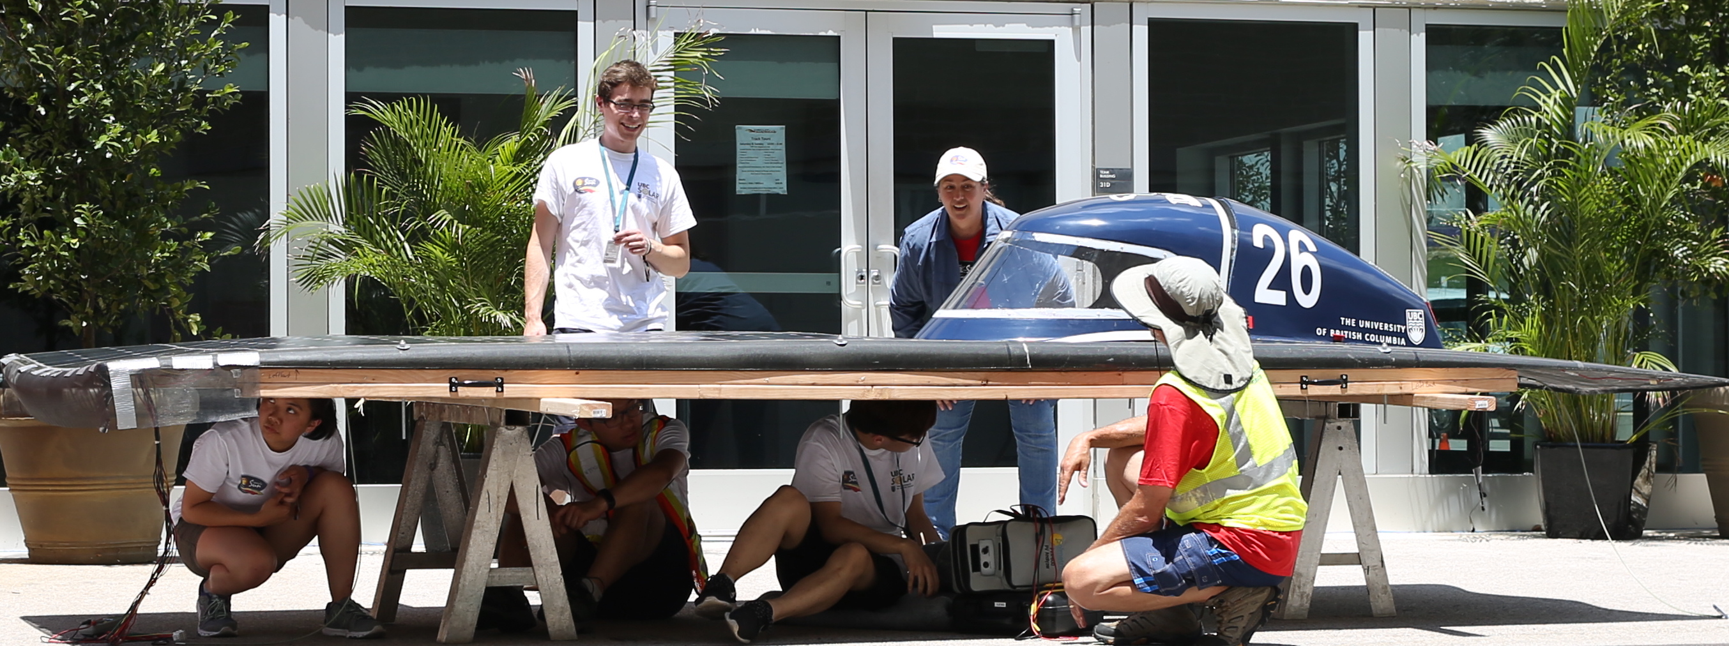
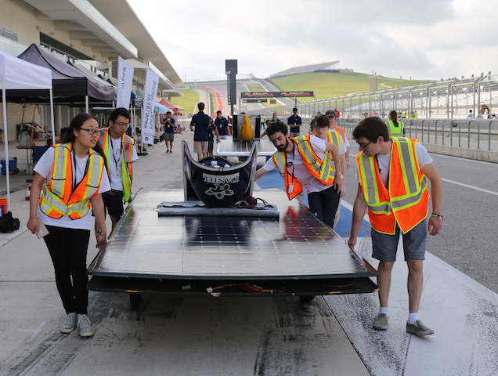
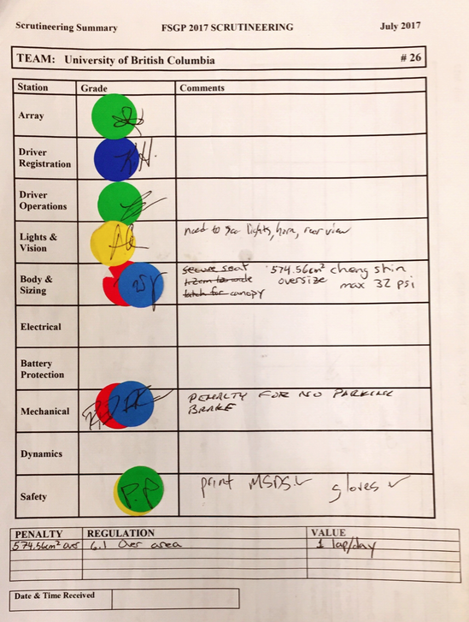
Competition Photos
(+Scrutineering sheet)

Slide 6
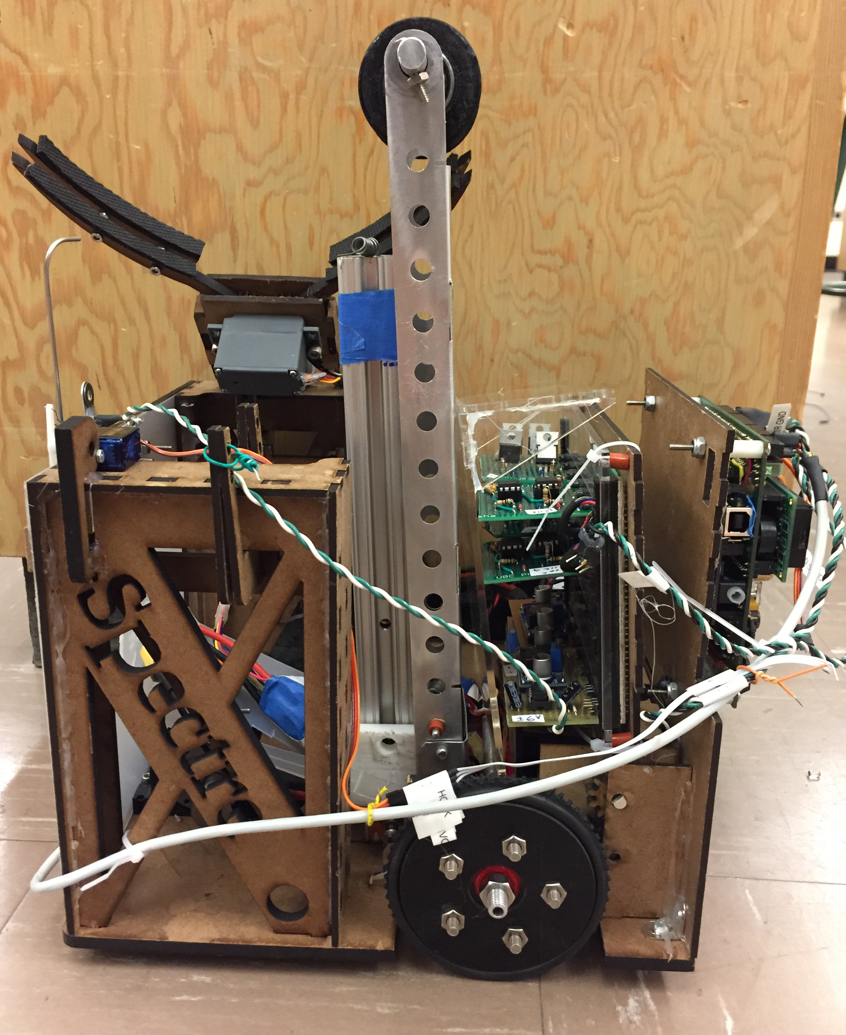
Engineering Physics Robot Compeition
(Autonomous Robot)
Designed powertrain w/ Stationary axle
Redesigned the chassis three times in Onshape
Rapidly manufactured all the mechanical components besides the arm.
Designed a robust winching system to pull the whole robot onto a tall pole

Slide 7
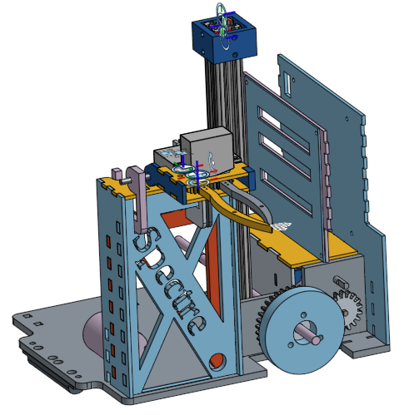
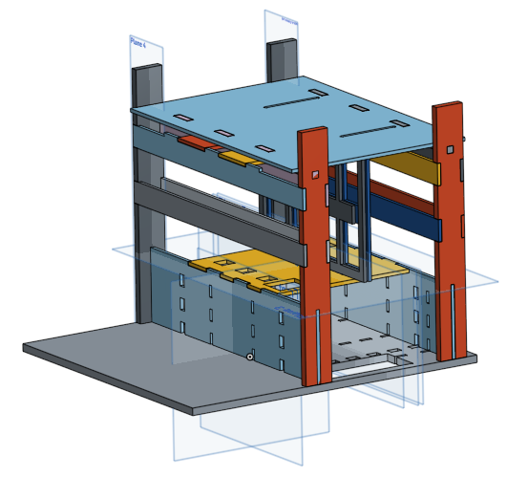
https://enph2020.github.io/robots/spectre/
Chassis
Left
Third Iteration
Assembled half of full robot
Bottom
Second Iteration

